Slide 1




































































































































































































































































































































































































































































































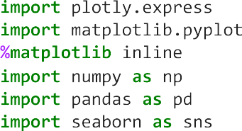

Slide 2
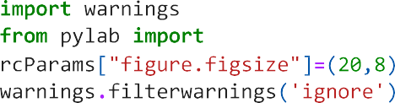
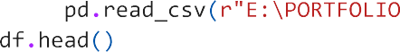



























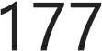





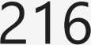





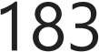





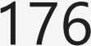




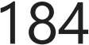
































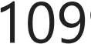

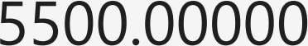
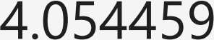

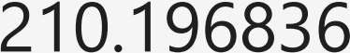
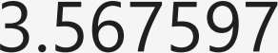
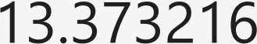
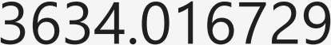

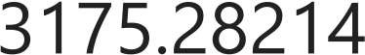


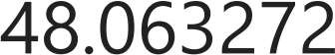

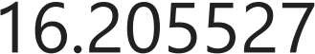
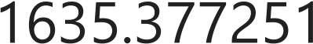




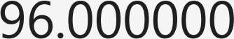














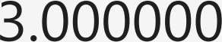
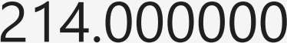
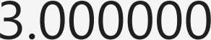






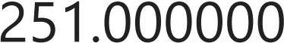









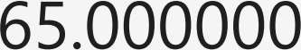



Slide 3


















Slide 4

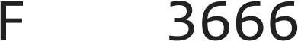

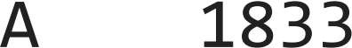




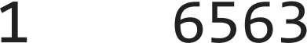







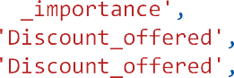

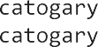














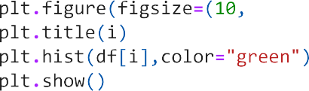

Slide 5
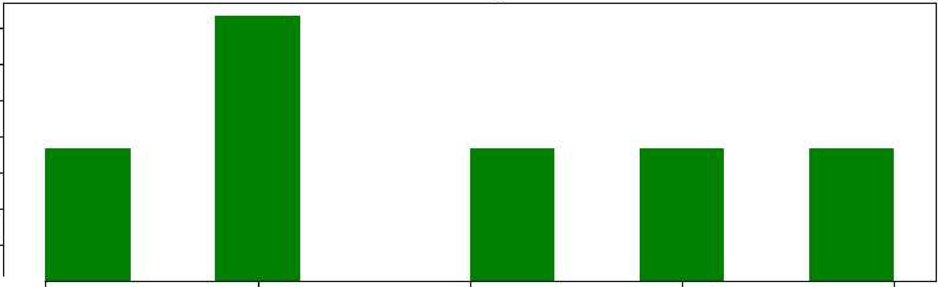
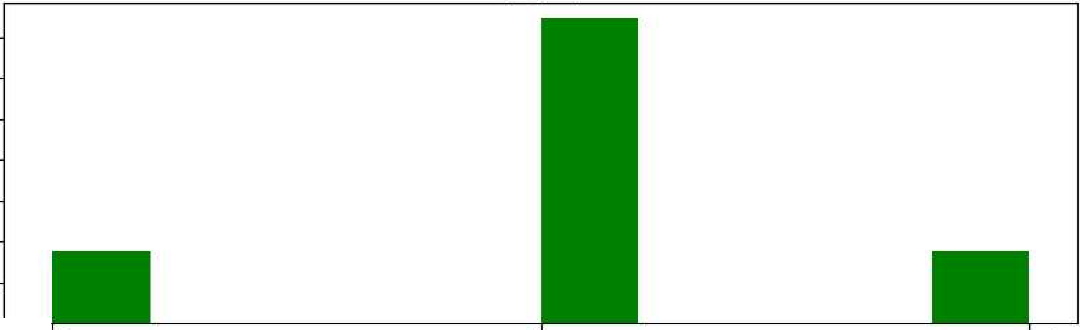
Warehouse block
3500
3000
2500
2000
1500
1000
500
o -
D
F
A
B
C
Mode·_of_ Shiipment
7000
6000
5000
4000
3000
2000
1000
o -
Fli,ght
Ship
Road

Slide 6



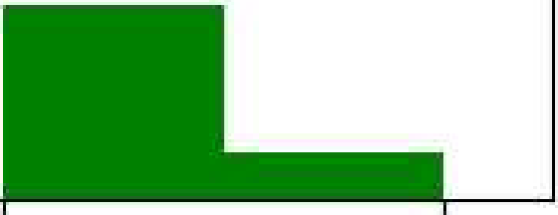
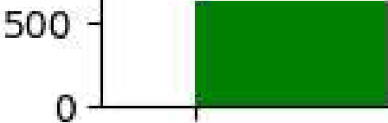
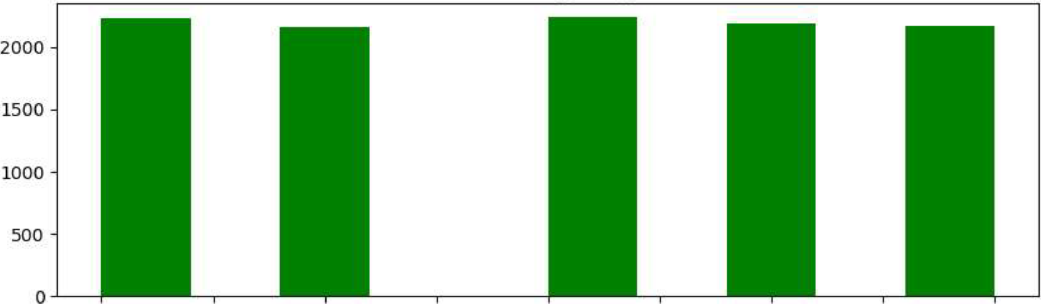
Customer₋caire calls
-
3500
3000
2.500
2000
1500
1000
2
4
5
6
7
Customer _rating
1.0
1.5
2.0
2.5
3.0
3.5
4.0
4.5
5.0

Slide 7
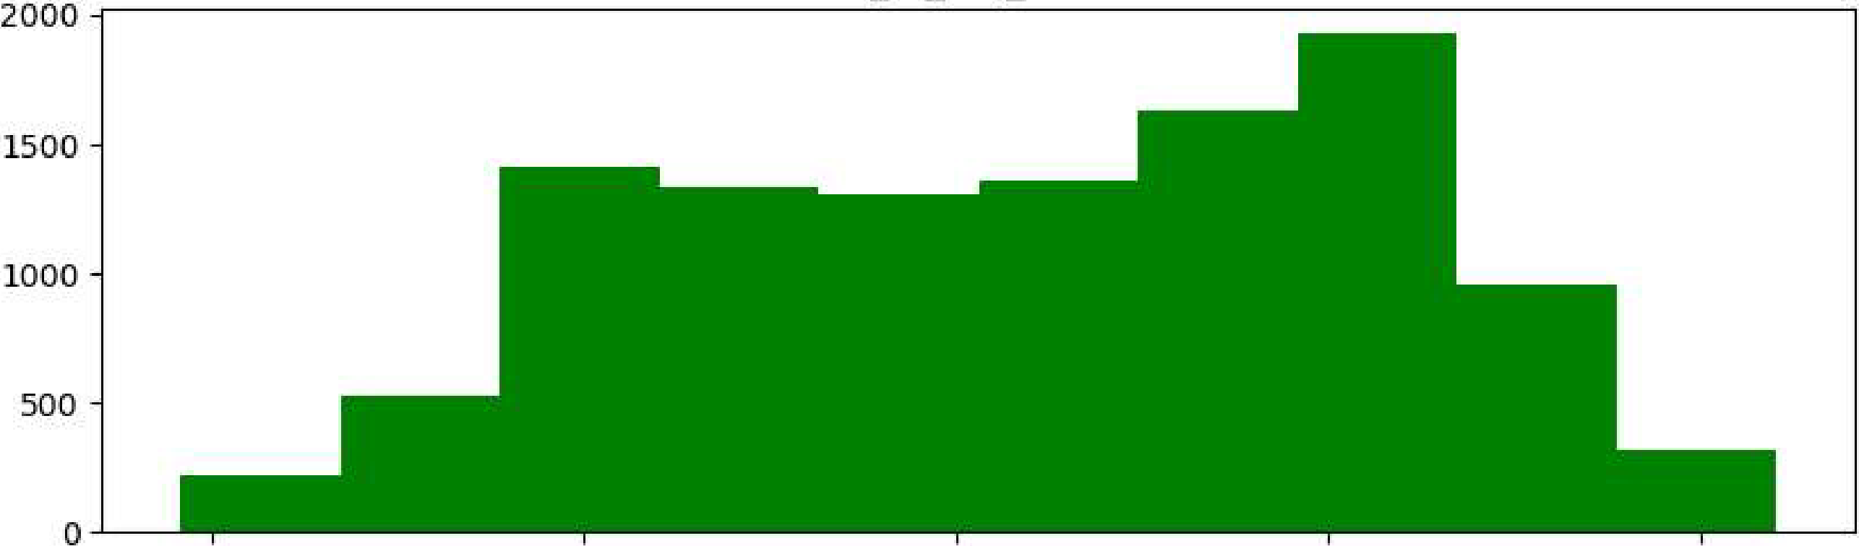
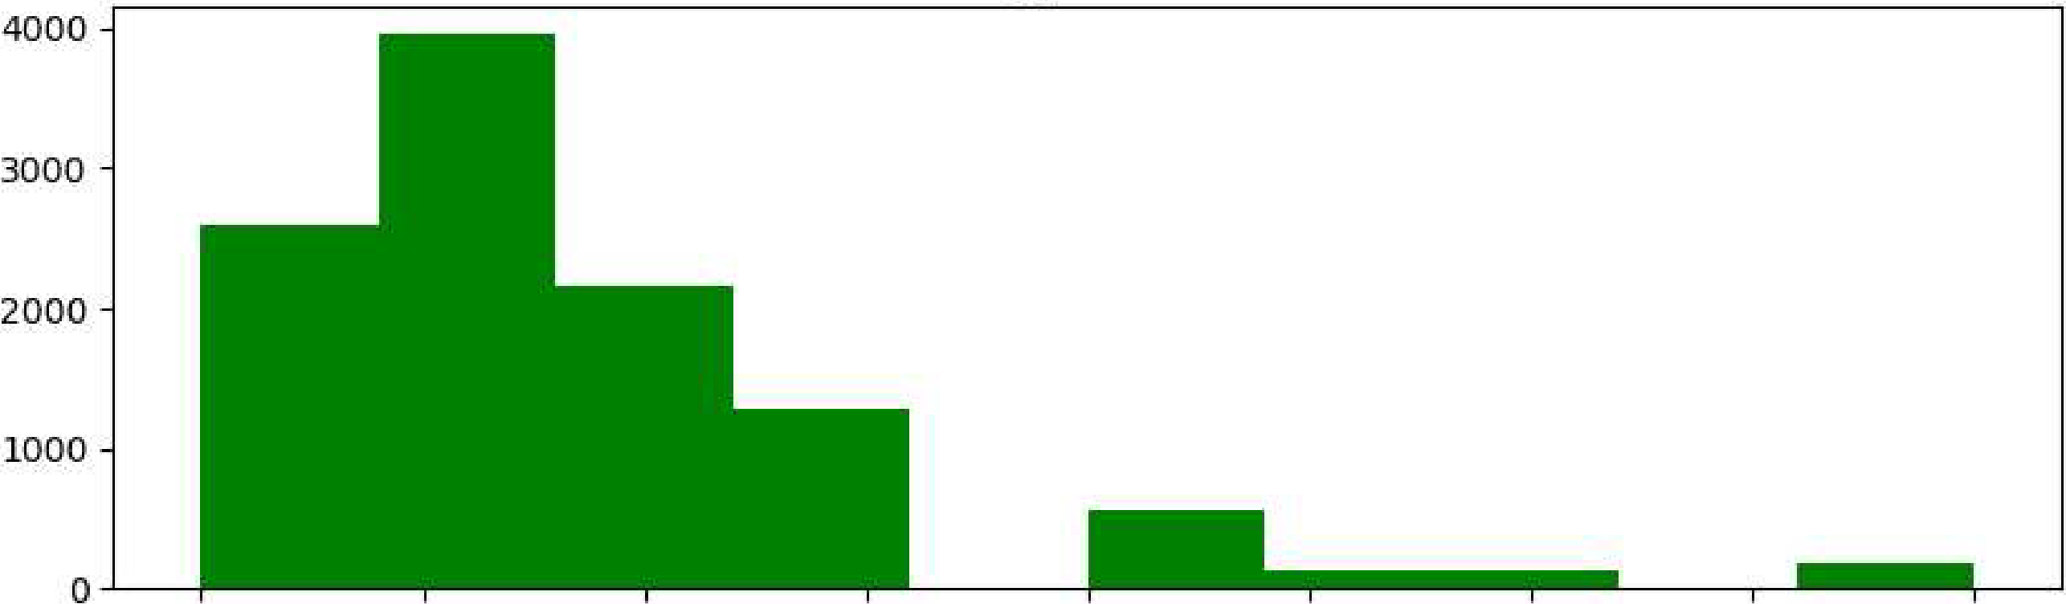
Cost of the Product
100
150
200
250
300
Prior_purchas.es
2
3
4
5
6
1
8
9
10

Slide 8
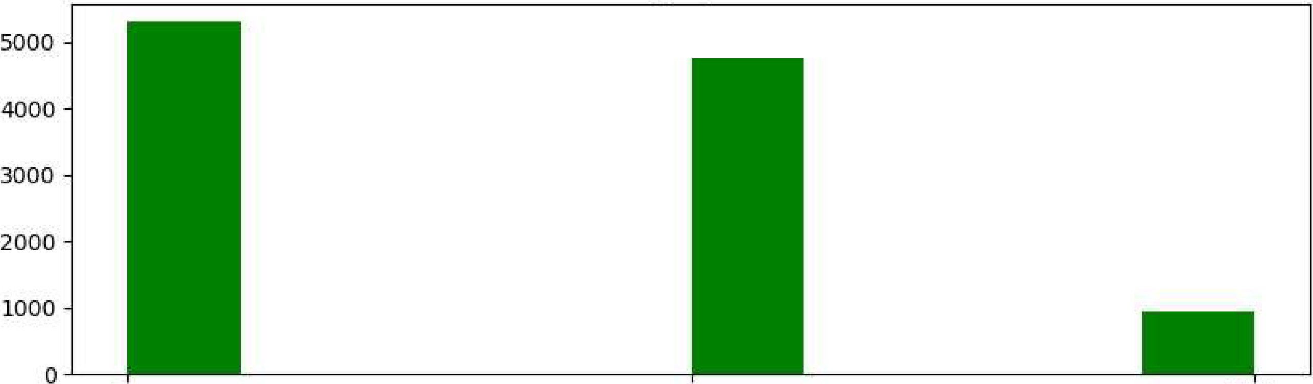
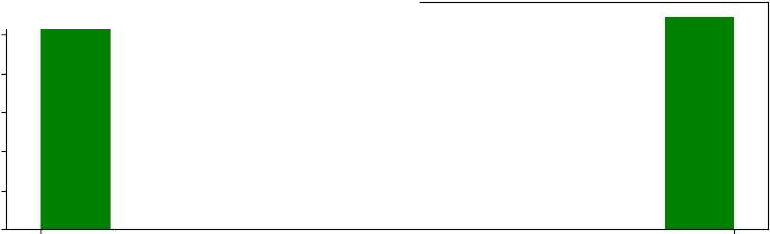
Product_importan,ce
low
medium
high
Gender
5000
4000
3000
2000
1000
0
F
M

Slide 9
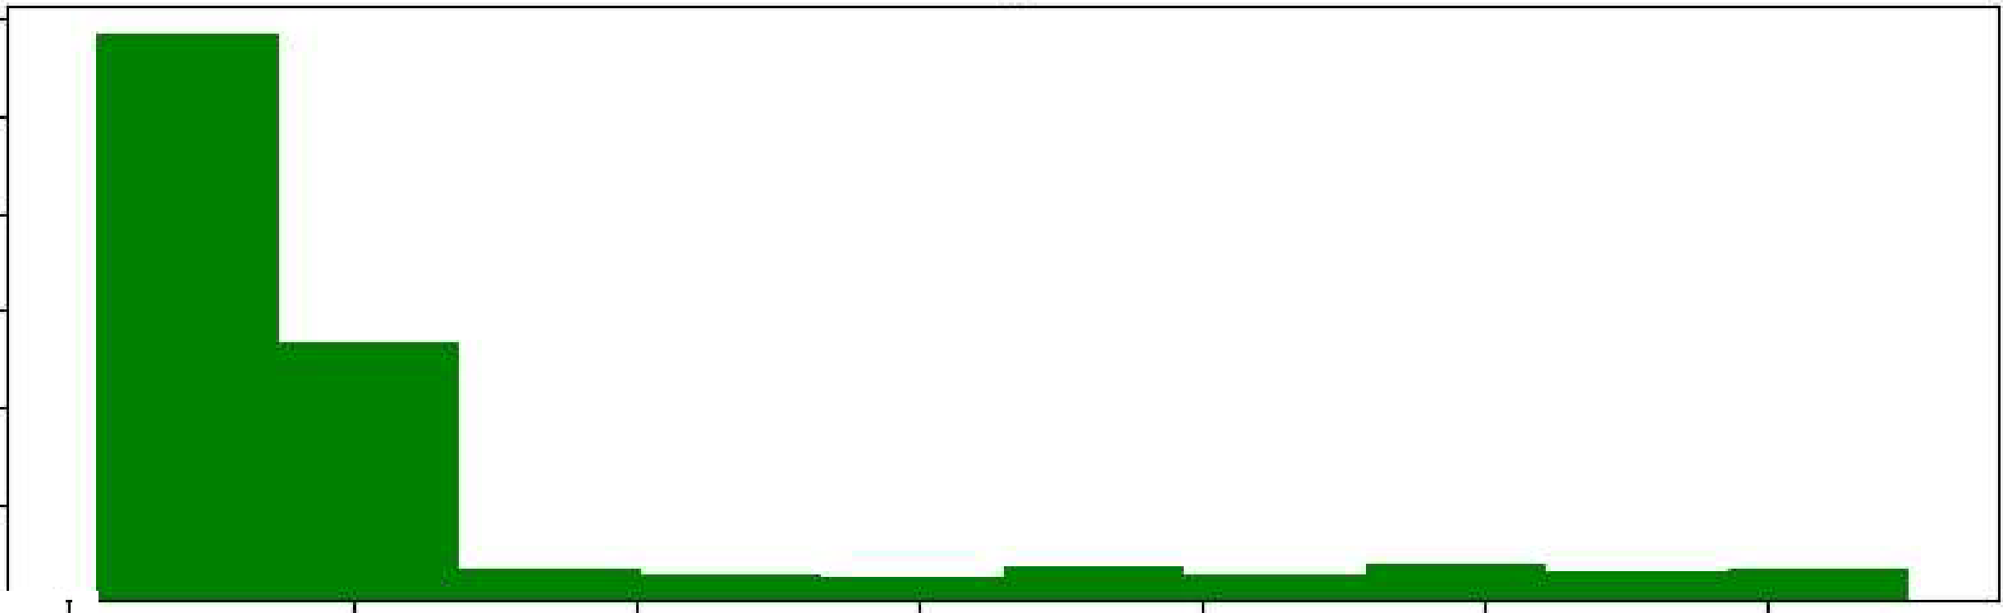
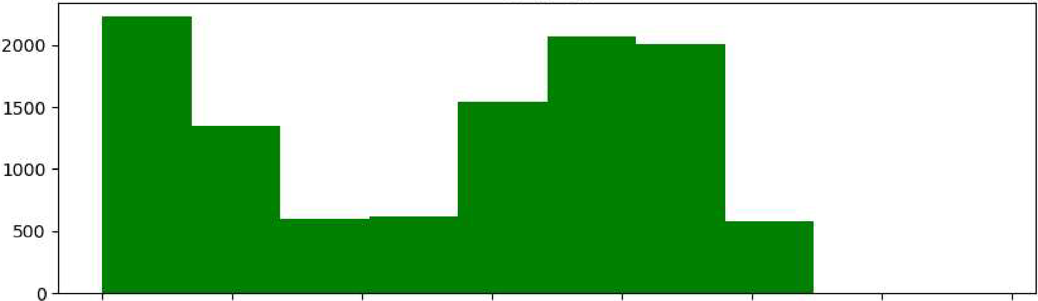
Discount offered
6000
5000
4000
3000
2000
1000
o
0
10
20
30
40
50
60
Weight_in_gms
1000
2000
3000
4000
5000
6000
7000
8000

Slide 10
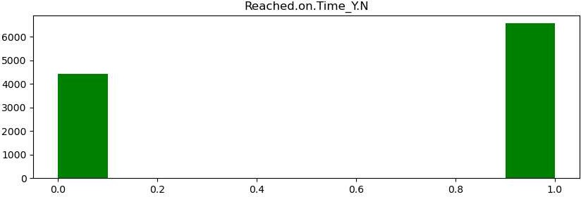

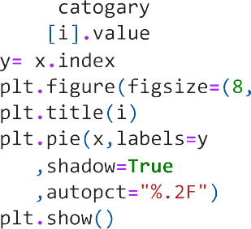

Slide 11
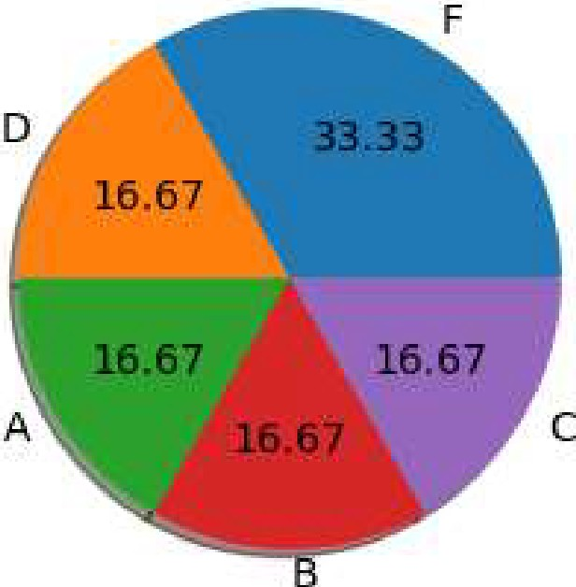
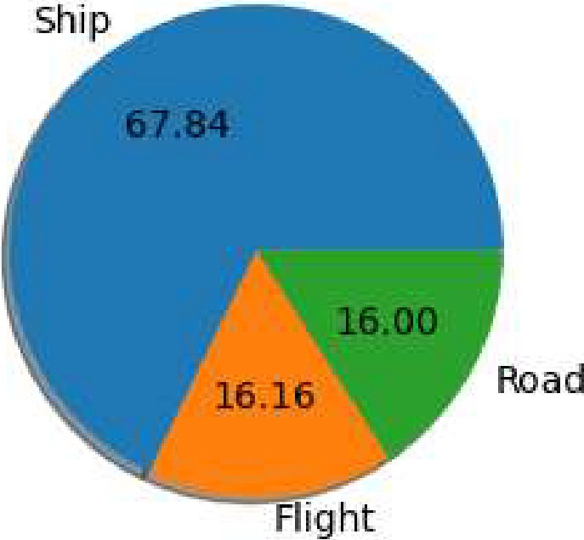
Warehouse block
Mode_of Shi:pm,ent

Slide 12
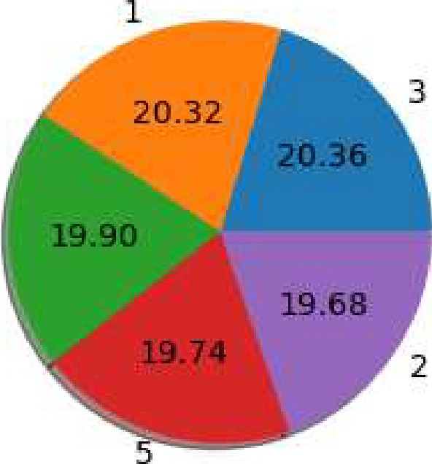
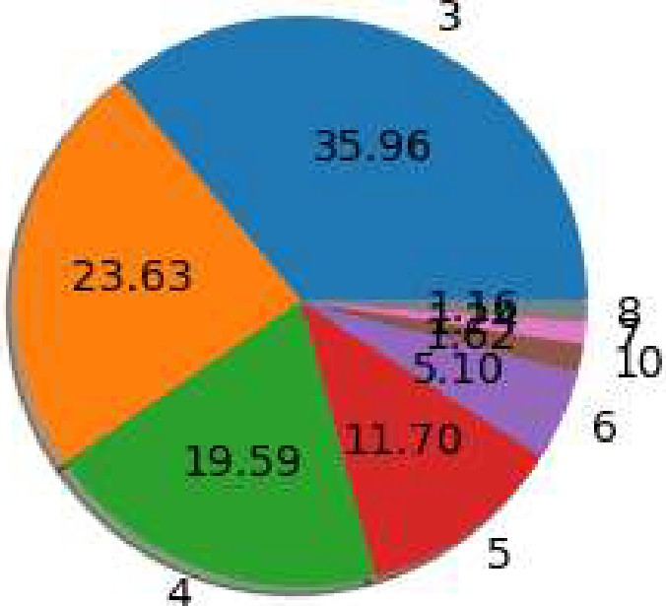
Customer_rating
4
Prior purchases
2

Slide 13
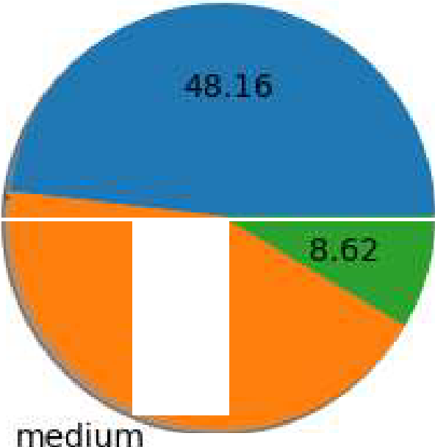
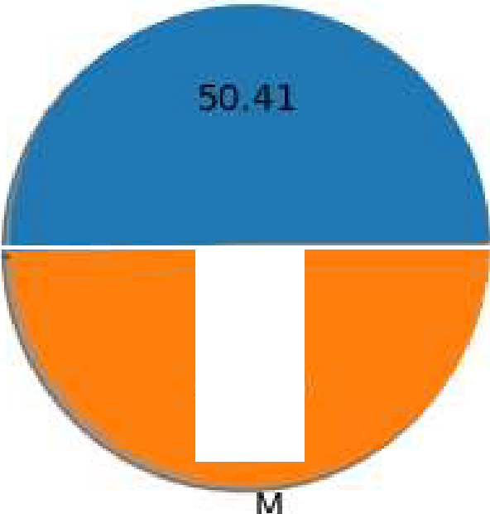
Product_i mp,ortance
low
high
43.22
Gender
F
49.59

Slide 14




Slide 15

Discount offered
0.12
0.10
0.08
0.04
0.02
o.oo L-L L--
-10 0
== :::5: = ==::S: ::::!::=:;:::::::i::::::,,_,_.,. _J
10 20 30 40 50
60
70
Discount_offered

Slide 16




Slide 17

Discount offered
0
10
20
30
Discount_offered
40
so
60

Slide 18




Slide 19


D
.:i.:::
₀u F
.c
0.,I
A
0
.c
ru
:...
j B
C
0.0
0.5
1.0
1.5
warehouse block
2.0
2-.5
3.0
Flight
,!,.I
C
Ill
E
C.
.c
1
01
w
"O
0
Shiip
:i:
Road
0.0
0.5
1.0
1.5
Warehouse block
2.0
2.5
3.0

Slide 20


1
2-
3
Warehouse block
4
5
3.5
3.0
UJ
&l 2.5
.'_{c}ti
:::::i
2-.0
C.
1o-¹ 1.5
0
't5: 1.0
0.5
0.0
l
2
3
Wa:rehouse block
4
5

Slide 21



low
Cl)
V
Cl'l
1=
0
Q. -
E medium
t, ^{I}
:::,
'C
£
high
0.0
0.5
1.0
1.5
Warehouse block
2.0
2.5
3.0
F
M
0.0
0.5
1.0
1.5
Warehouse block
2-.0
2.5
3.0

Slide 22




Slide 23




Slide 24

.11111111........,....."¥ ... --"·'· ..... ..-
5.0
•1m:amnar••.. ·-·
..••u:nm:nUIUIIIWll:l:■..IUl■IUUl.•IIU■
4.5
4.0
3.5
',i:i
('Cl
1.....1
w 3.0
0
a 2..s
.µ
l:ll
2.0
. D.IUIUDluunaH.......u■IU...-iu:■mim■nnl■H■IalUI■
1.5
1.0
0
10
20
40
Discounit offered
50
60
<Figure size 1000x1000 with 0 Axes>

Slide 25

5.0
•
4.5
4.0 (((811Jl18r.. •n1nim:ca:aanaDJI-( ---•■I■I■!■l
•
3.5
',i:i
('Cl
1.....1
w 3.0
0
a 2..s
.µ
l:ll
2.0 m:■JH■»l■llm.:aan.■:uJ,C.e-■lllellr.alC8'J UlDa E■R• ■
1.5
1.0
1000 2000 3000 4000 5000 6000 7000 8000
Weight_in_gms
<Figure size 1000x1000 with 0 Axes>

Slide 26
⁻ ,...--
....- ...^{-,-,...}
·- -⁻
n,,..,,7
I
I
I
I
I
5.0
4.5
4.0
3.5
',i:i
('Cl
1.....1
w 3.0
0
a 2..s
.µ
l:ll
2.0
1.5
1.0
100
15,0
200
Cost of the Product
250
300
<Figure size 1000x1000 with 0 Axes>

Slide 27















Slide 28

































































Slide 29













































































































































Slide 30



Slide 31
Fitting 5 folds for each of 10 candidates, totalling 50 fits
[CV] END max_depth=10, max_features=auto, min_samples_leaf=l, min_samples_split=6, n_estimators=100; total time= 13.65 [CV] END max_depth=10, max_features=auto, min_samples_leaf=l, min_samples_split=6, n_estimators=100; total time= 0.95 [CV] END max_depth=10, max_features=auto, min_samples_leaf=l, min_samples_split=6, n_estimators=100; total time= 1.2s [CV] END max_depth=10, max_features=auto, min_samples_leaf=l, min_samples_split=6, n_estimators=100; total time= 1.2s [CV] END max_depth=10, max_features=auto, min_samples_leaf=l, min_samples_split=6, n_estimators=100; total time= 0.95 [CV] END max_depth=None, max_features=sqrt, min_samples_leaf=2, min_samples_split=2, n_estimators=100; total time= 1. 8s
[CV] END max_depth=None, max_features=sqrt, min_samples_leaf=2, min_samples_split=2, n_estimators=100; total time= 1. 2s
[CV] END max_depth=None, max_features=sqrt, min_samples_leaf=2, min_samples_split=2, n_estimators=100; total time= 0.
9s
[CV] END max_depth=None, max_features=sqrt, min_samples_leaf=2, min_samples_split=2, n_estimators=100; total time= 1. 45
[CV] END max_depth=None, max_features=sqrt, min_samples_leaf=2, min_samples_split=2, n_estimators=100; total time= 1.
7s
[CV] END max_depth=30,
s
[CV] END max_depth=30,
s
[CV] END max_depth=30,
s
[CV] END max_depth=30,
s
[CV] END max_depth=30,
s
max_features=sqrt, min_samples_leaf=2, min_samples_split=6, n_estimators=1200; total time=
13.3
max_features=sqrt, min_samples_leaf=2, min_samples_split=6, n_estimators=1200; total time=
11.6
max_features=sqrt, min_samples_leaf=2, min_samples_split=6, n_estimators=1200; total time= 9.8
max_features=sqrt, min_samples_leaf=2, min_samples_split=6, n_estimators=1200; total time= 9.6
max_features=sqrt, min_samples_leaf=2, min_samples_split=6, n_estimators=1200; total time= 9.6
[CV] END max_depth=None, max_features=sqrt, min_samples_leaf=2, min_samples_split=6, n_estimators=200; total time= 2. 0s
[CV] END max_depth=None, max_features=sqrt, min_samples_leaf=2, min_samples_split=6, n_estimators=200; total time= 3. ls
[CV] END max_depth=None, max_features=sqrt, min_samples_leaf=2, min_samples_split=6, n_estimators=200; total time= 2. 95
[CV] END max_depth=None, max_features=sqrt, min_samples_leaf=2, min_samples_split=6, n_estimators=200; total time= 1.
95
[CV] END max_depth=None, max_features=sqrt, min_samples_leaf=2, min_samples_split=6, n_estimators=200; total time= 3. 05
[CV] END max_depth=30, [CV] END max_depth=30, [CV] END max_depth=30, [CV] END max_depth=30,
max_features=auto, min_samples_leaf=4, min_samples_split=2, n_estimators=100; total time= max_features=auto, min_samples_leaf=4, min_samples_split=2, n_estimators=100; total time= max_features=auto, min_samples_leaf=4, min_samples_split=2, n_estimators=100; total time= max_features=auto, min_samples_leaf=4, min_samples_split=2, n_estimators=100; total time=
1.0s
0.85
0.85
0.85
[CV] END max_depth=30, max_features=auto, min_samples_leaf=4, min_samples_split=2, n_estimators=100; total time= 0.85 [CV] END max_depth=None, max_features=sqrt, min_samples_leaf=2, min_samples_split=2, n_estimators=1200; total time= 1 4.35
[CV] END max_depth=None, max_features=sqrt, min_samples_leaf=2, min_samples_split=2, n_estimators=1200; total time= 1 4.55

Slide 32
[CV] END max_depth=None, max_features=sqrt, min_samples_leaf=2, min_samples_split=2, n_estimators=1200; total time= 1 4.4s
[CV] END max_depth=None, max_features=sqrt, min_samples_leaf=2, min_samples_split=2, n_estimators=1200; total time= 1 2.2s
[CV] END max_depth=None, max_features=sqrt, min_samples_leaf=2, min_samples_split=2, n_estimators=1200; total time= 1 2.0s
[CV] END max_depth=10, max_features=sqrt, min_samples_leaf=2, min_samples_split=4, n_estimators=500; total time= [CV] END max_depth=10, max_features=sqrt, min_samples_leaf=2, min_samples_split=4, n_estimators=500; total time= [CV] END max_depth=10, max_features=sqrt, min_samples_leaf=2, min_samples_split=4, n_estimators=500; total time= [CV] END max_depth=10, max_features=sqrt, min_samples_leaf=2, min_samples_split=4, n_estimators=500; total time=
3.4s
3.3s
3.3s
3.2s
[CV] END max_depth=10, max_features=sqrt, min_samples_leaf=2, min_samples_split=4, n_estimators=500; total time= 4.2s [CV] END max_depth=20, max_features=sqrt, min_samples_leaf=4, min_samples_split=2, n_estimators=1000; total time= 8.0 s
[CV] END max_depth=20, max_features=sqrt, min_samples_leaf=4, min_samples_split=2, n_estimators=1000; total time= 7.8
s
[CV] END max_depth=20, max_features=sqrt, min_samples_leaf=4, min_samples_split=2, n_estimators=1000; total time= s
[CV] END max_depth=20, max_features=sqrt, min_samples_leaf=4, min_samples_split=2, n_estimators=1000; total time=
s
[CV] END max_depth=20, max_features=sqrt, min_samples_leaf=4, min_samples_split=2, n_estimators=1000; total time= 9.0
s
[CV] END max_depth=20, max_features=auto, min_samples_leaf=2, min_samples_split=2, n_estimators=10; total time= [CV] END max_depth=20, max_features=auto, min_samples_leaf=2, min_samples_split=2, n_estimators=10; total time= [CV] END max_depth=20, max_features=auto, min_samples_leaf=2, min_samples_split=2, n_estimators=10; total time= [CV] END max_depth=20, max_features=auto, min_samples_leaf=2, min_samples_split=2, n_estimators=10; total time= [CV] END max_depth=20, max_features=auto, min_samples_leaf=2, min_samples_split=2, n_estimators=10; total time= [CV] END max_depth=20, max_features=sqrt, min_samples_leaf=l, min_samples_split=2, n_estimators=1200; total time= s
[CV] END max_depth=20, max_features=sqrt, min_samples_leaf=l, min_samples_split=2, n_estimators=1200; total time= s
[CV] END max_depth=20, max_features=sqrt, min_samples_leaf=l, min_samples_split=2, n_estimators=1200; total time= s
[CV] END max_depth=20, max_features=sqrt, min_samples_leaf=l, min_samples_split=2, n_estimators=1200; total time= s
[CV] END max_depth=20, max_features=sqrt, min_samples_leaf=l, min_samples_split=2, n_estimators=1200; total time=
s
RandomizedSearchCV(cv=5, estimator=RandomForestClassifier(n_jobs=-1), param_distributions={'max_depth': [None, 5, 10, 20, 30],
'max_features': ['auto', 'sqrt'], 'min_samples_leaf': [1, 2, 4],
'min_samples_split': [2, 4, 6],
'n_estimators': [10, 100, 200, 500,
1000, 1200]},
verbose=2)
7.7
13.0
0.0s
0.1s
0.2s
0.4s
0.2s
15.1
13.4
17.2
16.6
15.2
Out[42]:

Slide 33





















































Slide 38
Fitting 5 folds for each of 20 candidates, totalling 100 fits
[CV] END algorithm=auto, leaf_size=20, n_neighbors=3, p=l, weights=distance; total time= [CV] END algorithm=auto, leaf_size=20, n_neighbors=3, p=l, weights=distance; total time= [CV] END algorithm=auto, leaf_size=20, n_neighbors=3, p=l, weights=distance; total time= [CV] END algorithm=auto, leaf_size=20, n_neighbors=3, p=l, weights=distance; total time= [CV] END algorithm=auto, leaf_size=20, n_neighbors=3, p=l, weights=distance; total time= [CV] END algorithm=brute, leaf_size=20, n_neighbors=3, p=l, weights=uniform; total time= [CV] END algorithm=brute, leaf_size=20, n_neighbors=3, p=l, weights=uniform; total time= [CV] END algorithm=brute, leaf_size=20, n_neighbors=3, p=l, weights=uniform; total time= [CV] END algorithm=brute, leaf_size=20, n_neighbors=3, p=l, weights=uniform; total time= [CV] END algorithm=brute, leaf_size=20, n_neighbors=3, p=l, weights=uniform; total time= [CV] END algorithm=kd_tree, leaf_size=20, n_neighbors=9, p=2, weights=uniform; total time= [CV] END algorithm=kd_tree, leaf_size=20, n_neighbors=9, p=2, weights=uniform; total time= [CV] END algorithm=kd_tree, leaf_size=20, n_neighbors=9, p=2, weights=uniform; total time= [CV] END algorithm=kd_tree, leaf_size=20, n_neighbors=9, p=2, weights=uniform; total time= [CV] END algorithm=kd_tree, leaf_size=20, n_neighbors=9, p=2, weights=uniform; total time= [CV] END algorithm=auto, leaf_size=20, n_neighbors=4, p=2, weights=distance; total time= [CV] END algorithm=auto, leaf_size=20, n_neighbors=4, p=2, weights=distance; total time= [CV] END algorithm=auto, leaf_size=20, n_neighbors=4, p=2, weights=distance; total time= [CV] END algorithm=auto, leaf_size=20, n_neighbors=4, p=2, weights=distance; total time= [CV] END algorithm=auto, leaf_size=20, n_neighbors=4, p=2, weights=distance; total time= [CV] END algorithm=kd_tree, leaf_size=30, n_neighbors=3, p=2, weights=uniform; total time= [CV] END algorithm=kd_tree, leaf_size=30, n_neighbors=3, p=2, weights=uniform; total time= [CV] END algorithm=kd_tree, leaf_size=30, n_neighbors=3, p=2, weights=uniform; total time= [CV] END algorithm=kd_tree, leaf_size=30, n_neighbors=3, p=2, weights=uniform; total time= [CV] END algorithm=kd_tree, leaf_size=30, n_neighbors=3, p=2, weights=uniform; total time= [CV] END algorithm=brute, leaf_size=30, n_neighbors=l, p=2, weights=distance; total time= [CV] END algorithm=brute, leaf_size=30, n_neighbors=l, p=2, weights=distance; total time= [CV] END algorithm=brute, leaf_size=30, n_neighbors=l, p=2, weights=distance; total time= [CV] END algorithm=brute, leaf_size=30, n_neighbors=l, p=2, weights=distance; total time=
1.0s
1.ls 1.4s
1.3s
0.9s
1.6s
1.6s
1.0s
1.3s
1.9s
9.4s
0.2s
0.2s
0.2s
0.2s
1.0s
0.9s
0.9s
1.7s
1.0s
0.2s
0.2s
0.2s
0.2s
0.2s
1.0s
1.5s
0.8s
0.7s
[CV] END algorithm=brute, leaf_size=30, n_neighbors=l, p=2, weights=distance; total time= 0.7s [CV] END algorithm=ball_tree, leaf_size=20, n_neighbors=4, p=l, weights=distance; total time= 0.ls [CV] END algorithm=ball_tree, leaf_size=20, n_neighbors=4, p=l, weights=distance; total time= 0.ls [CV] END algorithm=ball_tree, leaf_size=20, n_neighbors=4, p=l, weights=distance; total time= 0.ls [CV] END algorithm=ball_tree, leaf_size=20, n_neighbors=4, p=l, weights=distance; total time= 0.ls [CV] END algorithm=ball_tree, leaf_size=20, n_neighbors=4, p=l, weights=distance; total time= 0.ls [CV] END algorithm=brute, leaf_size=15, n_neighbors=l, p=l, weights=uniform; total time= 1.4s [CV] END algorithm=brute, leaf_size=15, n_neighbors=l, p=l, weights=uniform; total time= 1.5s [CV] END algorithm=brute, leaf_size=15, n_neighbors=l, p=l, weights=uniform; total time= 1.ls [CV] END algorithm=brute, leaf_size=15, n_neighbors=l, p=l, weights=uniform; total time= 1.4s [CV] END algorithm=brute, leaf_size=15, n_neighbors=l, p=l, weights=uniform; total time= 1.7s [CV] END algorithm=ball_tree, leaf_size=15, n_neighbors=l, p=2, weights=uniform; total time= 0.2s [CV] END algorithm=ball_tree, leaf_size=15, n_neighbors=l, p=2, weights=uniform; total time= 0.2s [CV] END algorithm=ball_tree, leaf_size=15, n_neighbors=l, p=2, weights=uniform; total time= 0.2s [CV] END algorithm=ball_tree, leaf_size=15, n_neighbors=l, p=2, weights=uniform; total time= 0.2s

Slide 39
[CV] END algorithm=ball_tree, leaf_5ize=l5, n_neighbor5=l, p=2, weight5=uniform; total time= [CV] END algorithm=kd_tree, leaf_5ize=20, n_neighbor5=l0, p=2, weight5=di5tance; total time= [CV] END algorithm=kd_tree, leaf_5ize=20, n_neighbor5=l0, p=2, weight5=di5tance; total time= [CV] END algorithm=kd_tree, leaf_5ize=20, n_neighbor5=l0, p=2, weight5=di5tance; total time= [CV] END algorithm=kd_tree, leaf_5ize=20, n_neighbor5=l0, p=2, weight5=di5tance; total time= [CV] END algorithm=kd_tree, leaf_5ize=20, n_neighbor5=l0, p=2, weight5=di5tance; total time= [CV] END algorithm=kd_tree, leaf_5ize=l5, n_neighbor5=8, p=l, weight5=di5tance; total time= [CV] END algorithm=kd_tree, leaf_5ize=l5, n_neighbor5=8, p=l, weight5=di5tance; total time= [CV] END algorithm=kd_tree, leaf_5ize=l5, n_neighbor5=8, p=l, weight5=di5tance; total time= [CV] END algorithm=kd_tree, leaf_5ize=l5, n_neighbor5=8, p=l, weight5=di5tance; total time= [CV] END algorithm=kd_tree, leaf_5ize=l5, n_neighbor5=8, p=l, weight5=di5tance; total time= [CV] END algorithm=ball_tree, leaf_5ize=20, n_neighbor5=3, p=l, weight5=Uniform; total time= [CV] END algorithm=ball_tree, leaf_5ize=20, n_neighbor5=3, p=l, weight5=Uniform; total time= [CV] END algorithm=ball_tree, leaf_5ize=20, n_neighbor5=3, p=l, weight5=Uniform; total time= [CV] END algorithm=ball_tree, leaf_5ize=20, n_neighbor5=3, p=l, weight5=uniform; total time= [CV] END algorithm=ball_tree, leaf_5ize=20, n_neighbor5=3, p=l, weight5=uniform; total time= [CV] END algorithm=kd_tree, leaf_5ize=20, n_neighbor5=2, p=l, weight5=uniform; total time= [CV] END algorithm=kd_tree, leaf_5ize=20, n_neighbor5=2, p=l, weight5=uniform; total time= [CV] END algorithm=kd_tree, leaf_5ize=20, n_neighbor5=2, p=l, weight5=uniform; total time= [CV] END algorithm=kd_tree, leaf_5ize=20, n_neighbor5=2, p=l, weight5=uniform; total time=
0.25
0.15
0.15
0.25
0.15
0.15
0.25
0.25
0.15
0.15
0.15
0.25
0.25
0.25
0.25
0.25
0.25
0.25
0.25
0.15
[CV] END algorithm=kd_tree, leaf_5ize=20, n_neighbor5=2, p=l, weight5=uniform; total time= 0.25 [CV] END algorithm=ball_tree, leaf_5ize=20, n_neighbor5=6, p=l, weight5=di5tance; total time= 0.15
[CV] END algorithm=ball_tree, leaf_5ize=20, n_neighbor5=6, p=l, weight5=di5tance; total time= [CV] END algorithm=ball_tree, leaf_5ize=20, n_neighbor5=6, p=l, weight5=di5tance; total time= [CV] END algorithm=ball_tree, leaf_5ize=20, n_neighbor5=6, p=l, weight5=di5tance; total time= [CV] END algorithm=ball_tree, leaf_5ize=20, n_neighbor5=6, p=l, weight5=di5tance; total time= [CV] END algorithm=ball_tree, leaf_5ize=l5, n_neighbor5=9, p=l, weight5=Uniform; total time= [CV] END algorithm=ball_tree, leaf_5ize=l5, n_neighbor5=9, p=l, weight5=Uniform; total time= [CV] END algorithm=ball_tree, leaf_5ize=l5, n_neighbor5=9, p=l, weight5=Uniform; total time= [CV] END algorithm=ball_tree, leaf_5ize=l5, n_neighbor5=9, p=l, weight5=Uniform; total time=
0.05
0.15
0.05
0.15
0.25
0.25
0.25
0.25
[CV] END algorithm=ball_tree, leaf_5ize=l5, n_neighbor5=9, p=l, weight5=uniform; total time= [CV] END algorithm=kd_tree, leaf_5ize=l5, n_neighbor5=l, p=2, weight5=uniform; total time= [CV] END algorithm=kd_tree, leaf_5ize=l5, n_neighbor5=l, p=2, weight5=uniform; total time= [CV] END algorithm=kd_tree, leaf_5ize=l5, n_neighbor5=l, p=2, weight5=uniform; total time= [CV] END algorithm=kd_tree, leaf_5ize=l5, n_neighbor5=l, p=2, weight5=uniform; total time=
0.25
0.25
0.25
0.25
0.25
[CV] END algorithm=kd_tree, leaf_5ize=l5, n_neighbor5=l, p=2, weight5=uniform; total time= 0.25 [CV] END algorithm=brute, leaf_5ize=20, n_neighbor5=4, p=2, weight5=di5tance; total time= 0.95 [CV] END algorithm=brute, leaf_5ize=20, n_neighbor5=4, p=2, weight5=di5tance; total time= 0.95 [CV] END algorithm=brute, leaf_5ize=20, n_neighbor5=4, p=2, weight5=di5tance; total time= 0.95 [CV] END algorithm=brute, leaf_5ize=20, n_neighbor5=4, p=2, weight5=di5tance; total time= 0.95 [CV] END algorithm=brute, leaf_5ize=20, n_neighbor5=4, p=2, weight5=di5tance; total time= 1.35 [CV] END algorithm=auto, leaf_5ize=20, n_neighbor5=9, p=2, weight5=Uniform; total time= 1.05
[CV] END algorithm=auto, leaf_5ize=20, n_neighbor5=9, p=2, weight5=Uniform; total time= [CV] END algorithm=auto, leaf_5ize=20, n_neighbor5=9, p=2, weight5=Uniform; total time= [CV] END algorithm=auto, leaf_5ize=20, n_neighbor5=9, p=2, weight5=Uniform; total time=
1.05
0.95
0.95

Slide 46
4000
3500
0
3000
2500
Q)
rn
QJ
.Q
2000
1500
l
1000
500
Q
1.
Predicted label
kNN Model

Slide 48
4000
3500
0
3000
2500
Q)
rn
QJ
.Q
2000
1500
l
1000
500
Q
1.
Predicted label
NB Model

Slide 50
4000
3500
0
3000
2500
Q)
rn
QJ
.Q
2000
1500
l
1000
500
Q
1.
Predicted label
Conclusion

Slide 51
In conclusion, the analysis conducted on the e-commerce data involved data preparation, visualization, and the application of various machine learning models. The Random Forest Model, kNN Model, and Naive Bayes Model were used to gain insights and make predictions related to shipping events. Additionally, clustering was performed using the K-Means algorithm to identify patterns in the shipping data. The classification matrix was used to evaluate the performance of the models. The results of this analysis can help the e­ commerce company improve their shipping operations, make informed decisions, and enhance customer satisfaction.

